Slide 1
The Case for Performance Interfaces for Hardware Accelerators
Rishabh Iyer, Jiacheng Ma, Katerina Argyraki, George Candea, Sylvia Ratnasamy
Notes:
Thanks Marios, for the introduction — (adapt to Marios’ introduction) With last names
In this talk, I will argue that the way we use hardware accelerators MUST change.

Slide 2
Performance interfaces for hardware accelerators are necessary and feasible
Notes:
I will argue two points in particular
First, hardware accelerators, that exist solely to improve system performance MUST come with performance interfaces, i.e., interfaces that summarize their latency and throughput just like traditional semantic interfaces describe functionality.
Second, such interfaces for accelerators are feasible. I will propose three candidate representations and discuss how each of them can be useful to system developers.

Slide 3
Performance interfaces for hardware accelerators are necessary and feasible
Notes:
So let’s start with why performance interfaces are necessary

Slide 4
Accelerators are here to stay
General-purpose HW can’t keep up with growing computational demand
System designers are increasingly turning to accelerators
Machine learning (Google TPU)
Video processing (Meta Shasta)
Systems infrastructure (AWS Nitro)
Notes:
Hardware accelerators are expected to become ubiquitous in the near future.
With the decline of Moore’s law and the end of Dennard scaling, general-purpose hardware can no longer keep up with the computational demands of modern applications.
And so, we’re seeing system designers increasingly turn to accelerators to speedup a wide variety of tasks such as machine learning, video processing and systems infrastructure tasks.
A quick note, in this work we use the term “accelerators” to refer to ASICs whose functionality is baked into silicon. We do not consider programmable hardware such as FPGAs and GPUs.

Slide 5
Accelerators are hard to use!
Accelerators provide little visibility into expected performance
Only way to gauge speedup: purchase accelerator, port and run code
2-3 person-months in the best case
Impossible during system design when no code exists
Offloading blindly can degrade performance
Every accelerator makes assumptions about expected workload
Building systems that use accelerators is tedious and error-prone
Notes:
While accelerators promise performance benefits, building systems that use accelerators effectively remains challenging.
The primary reason for this is that accelerators do not provide usable information about their expected performance.
The only way for developers to gain any visibility into expected performance is by purchasing the accelerator, porting the code and benchmarking it; a process that ranges from being tedious to impossible.
In the best-case it will take 2-3 months per accelerator since each accelerator exposes a different API/SDK and in the worst case, such as during the system design stage when no code has been written, it is downright impossible.
I will now quickly describe three examples that depict this status quo.

Slide 6
Example #1: SoC design
Need to decide
Which third-party IP blocks to use?
Area allocated per accelerator?
Where are the compute and memory bottlenecks?
No good way to answer these questions:
Benchmarking is tedious/infeasible
Must rely on heuristics and “accumulated wisdom”
Notes:
For the first example, put yourself in the shoes of the lead designer for an SoC (e.g., for a SmartNIC). This process involves putting together accelerators that are designed by third party entities and sold as IP blocks.
As the SoC designer, you need to answer questions such as: “Which accelerator implementations (IP blocks) should my SoC include? How much area should I assign to each and how will that impact the compute and memory bottlenecks for different workloads?”
Unfortunately, there is no good way to answer these question today because each of these IP blocks are usually black boxes w.r.t expected performance.
You can try answering these questions by porting example workloads but for most SoCs, the search-space of all possible IP block combinations is just too large.

Slide 7
Example #2: Infrastructure stack offload
Imagine you want to offload an RPC stack to hardware
Must purchase and port code to every accelerator to decide
Which accelerator provides best performance per dollar?
How many server cores can I save?
Notes:
You would face similar visibility issues if you were the engineer responsible for managing the RPC stack and wanted to offload it to an accelerator.
The only way you’d be able to decide which accelerator gave you the best performance per unit cost is by purchasing every candidate accelerator, porting the core and benchmarking it.

Slide 8
Example #3: Compilers for accelerators
ML compilers (e.g., TVM) auto-tune code to available hardware
Derive program-specific cost models by profiling hardware
Auto-tuning provides up to 4x performance benefits
Auto-tuning can take several hours
Bottlenecked by profiling (91-99% of total time for Resnet-18)¹
Compilers cannot quickly estimate latency of an instruction sequence
¹Adatune: Adaptive tensor compilation made efficient. Li et. al, NEURIPS’20
Notes:
Finally, just like developers, tools that use accelerators also suffer from the lack of performance visibility. I will now demonstrate this using the example of TVM [12], a widely used state-of-the-art ML compiler.
To optimize inference latency, TVM “auto-tunes” code to each target accelerator. This involves extracting a program-specific cost model based on extensive profiling of the accelerator.
However, autotuning code is painfully slow and is bottlenecked by the profiling step, with recent results showing that it can take up to 99% of the total time. Profiling is the bottleneck because the compiler has no way to estimate the expected latency of an instruction sequence and so must resort to either running cycle-accurate simulations or synthesizing and running the code directly on the accelerator. Both of these options are slow, and as a result, end-to-end compilation with TVM can end up taking several hours.

Slide 9
Key questions for accelerators
What latency/throughput can I expect for my workload?
Which accelerator is the best fit for my workload?
How does offloading (a part of) my code impact end-to-end performance?
Which parts of my code should I offload?
Answering these questions is key to the effective use of accelerators
Notes:
[Key questions:] So this is the status quo w.r.t how accelerators are used today. I think we can all agree that it must change.
If we take a step back, we see that in each of the previous three examples developers are trying to answer the same two questions:
First, what is the expected latency/throughput of MY workload on this accelerator? This allows them to decide the best accelerator for their workload?
And second, how does offloading a part of the code impact e2e system performance? This allows them to decide the parts of the system worth offloading.
So how do we best enable developers and tools to answer these questions?

Slide 10
Equivalent questions for functionality
Performance
Functionality
Expected latency/throughput?
Best accelerator for workload?
Functionality provided by third-party library?
Best library for my workload?
E2E impact of partial offload? What to offload?
Impact of using library on overall functionality?
Which libraries to use?
Notes:
We draw inspiration from how the same questions for functionality are answered today.
On this slide, we see equivalent questions w.r.t the functionality of a third-party library so: what functionality the third party library provides, which library is the best fit for a developer’s workload, how using a library impacts e2e functionality.

Slide 11
Equivalent questions for functionality
Performance
Functionality
Expected latency/throughput?
Best accelerator for workload?
Functionality provided by third-party library?
Best library for my workload?
E2E impact of partial offload? What to offload?
Impact of using library on overall functionality?
Which libraries to use?
Developers routinely answer the above questions using semantic interfaces (e.g., code documentation, header files, specifications)
Notes:
These questions don’t look so challenging, and in fact developers routinely answer them on a day-to-day basis using semantic interfaces such as code documentation, header files and specifications.

Slide 12
Performance interfaces for accelerators
Describe an accelerator’s externally visible performance
Just like semantic interfaces describe functionality
Take in the same input(s) as the accelerator
Describe latency, throughput as a function of the input(s)
Provide no information about semantics
Since accelerators are only useful if they improve performance, performance interfaces are integral to their effective use
Notes:
So we argue that accelerators must come with equivalent PERFORMANCE INTERFACES.
A performance interface takes in the same inputs as the accelerator and describes its externally visible performance (latency and throughput) as a function of the inputs.
Two key points I want to emphasize about performance interfaces:
First, like any interface, they only describe the EXTERNALLY visible behavior that a client needs to know. So the interface need not breakdown the accelerator’s performance beyond the boundaries of the accelerator, for instance, individual pipeline stages.
Second, a performance interface only describes performance; the semantics of the accelerator are not its concern. This allows performance interfaces to remain simple, since they can abstract away all details only relevant to functionality.
Given that accelerators are only useful if they improve system performance, we believe that such performance interfaces are integral to their broad and effective use.

Slide 13
Performance interfaces for hardware accelerators are necessary and feasible
Notes:
So, thus far I've argued that performance interfaces for accelerators are necessary.
Let me know describe why I think they are feasible

Slide 14
Running examples
Four open-source accelerators
Bitcoin miner
JPEG decoder
RPC data (de)serialization (Protoacc)
Deep learning (VTA)
Notes:
Throughout this section, I will use 4 open-source accelerators as running examples: a Bitcoin miner [8], a JPEG decoder [35], an RPC message (de)serializer from Google named Protoacc [36] and the VTA deep-learning accelerator [42]. The last two in particular are fairly complex with deep pipelines, internal queues and asynchronous processing. Four tiles.

Slide 15
What should performance interfaces look like?
Upper/lower bounds
Natural language (code documentation)
Simple programs (functional specifications)
Performance IR using Petri nets (IRs like LLVM)
Readability
Cycle-accurate model,
Accelerator implementation
Existing interfaces
Our proposals
Precision
Notes:
A key question we need to answer is what should the performance interface for an accelerator look like?
Any representation must provide a balance between readability (that is, how easy it is to understand) and precision (how accurately it can reason about performance).
The only interfaces available to developers and tools today occupy the two ends of the spectrum.
Accelerators, sometimes come with upper/lower bounds which maximize readability but provide little useful information for realistic workloads.
Or, developers are forced to rely on cycle-accurate models and the accelerator’s implementation itself, both of which are perfectly precise but hard to understand and really overkills as interfaces.
[Pause] In this work, we propose three candidate representations (1) natural language text akin to documentation, (2) simple, executable programs akin to functional specifications, and (3) a precise intermediate representation using Petri nets akin to IRs like LLVM that allow compilers to reason about software semantics.
Each interface provides a different balance between readability and precision:
Natural language interfaces are the easiest to read but can only describe a few key performance properties.
Programs are slightly harder for developers to read but can provide more details, and
Finally, Petri nets are not meant to be human readable but can accurately predict the accelerator’s throughput and latency for arbitrary workloads.

Slide 16
What should performance interfaces look like?
Upper/lower bounds
Natural language (code documentation)
Simple programs (functional specifications)
Performance IR using Petri nets (IRs like LLVM)
Readability
Cycle-accurate model,
Accelerator implementation
Existing interfaces
Our proposals
Precision
Notes:
I will now walk you through each representation, starting with the natural language text

Slide 17
Interfaces as natural language: examples
JPEG decoder
Latency is inversely proportional (linearly) to the input image’s compression ratio
Bitcoin miner
Latency in clock cycles is equal to the configuration parameter Loop.
Notes:
On this slide, you see two example interfaces for the JPEG decoder and Bitcoin miner..
The interface for the decoder tells you that the latency is inversely proportional to the compression ratio (that is the ratio of the output image size to the input image size). This is the case since the accelerator must perform a similar computation on every input byte.
The interface for the Bitcoin miner tells the user that they can use the configuration parameter “Loop”, which represents how many times the accelerator’s internal loop is unrolled in hardware to set the latency of the accelerator

Slide 18
Interfaces as natural language: rationale
While simple, such interfaces have two main benefits:
Still useful; describe trends for what are otherwise black boxes
Lowest barrier to adoption
Notes:
These interfaces are undoubtedly simple, but we propose them for 2 reasons:
First they represent an improvement over the status quo and give developers visibility into what are otherwise black boxes.
Second, we believe they provide the lowest barrier to adoption and could be an important step in making performance interfaces for accelerators a reality. This is because, in all our discussions with accelerator builders, it took them only a couple of minutes to come up with such interfaces for their hardware.

Slide 19
What should performance interfaces look like?
Upper/lower bounds
Natural language (code documentation)
Simple programs (functional specifications)
Performance IR using Petri nets (IRs like LLVM)
Readability
Cycle-accurate model,
Accelerator implementation
Existing interfaces
Our proposals
Precision
Notes:
Moving on to interfaces as simple executable programs,

Slide 20
Interfaces as simple, executable programs
def latency_jpeg_decode(img):
size = img.orig_size/64
return max (size*136.5,
size/64*(15/img.compress_ratio+6)*1.5)
def throughput_jpeg_decode(img):
# images are processed one at a time
return 1/latency_jpeg_decode(img)
Notes:
On this slide, you see the programmatic performance interfaces for the JPEG decoder’s latency and throughput. Both programs take the same input as the accelerator (the image to be decoded) and describe latency and throughput as a function of the image.
The most important aspect of such interfaces is that allow developers to quickly yet accurately estimate how performance varies across different inputs. For instance, developers can read this interface and compute how quickly their images will be decoded using just this interface. They no longer need to purchase the accelerator or port code to it.

Slide 21
Representing performance as programs
Manually derived programmatic interfaces for 3 accelerators
1 person-day per accelerator
Hard to derive for VTA which has an ISA.
Can predict throughput and latency with reasonable accuracy
Tested using random workloads (e.g., 1500 random images)
Average prediction error of 2 - 6% across 3 accelerators.
Notes:
We formulate these interfaces manually, for 3 accelerators. Each formulation took us roughly 1 person day.
Extracting a program for VTA was hard, because unlike the other accelerators, VTA has an ISA and so each task can be an arbitrary sequence of instructions. Since performance of each instruction is heavily context-dependent, we were unable to come up with a simple closed form function for arbitrary tasks.
This leads us to believe that interfaces as programs are best-suited to accelerators that are fixed function ASICs, of which there are many.
We evaluated the prediction accuracy for each program using random inputs (e.g., 1500 random images for JPEG, 32 random message formats for Protoacc). For each accelerator, we ran these random inputs compared the measured performance to the values predicted by the programs and observed an average prediction error of between 2-6%.
This experience makes us positive that such interfaces can be of great use for developers seeking to make quick but informed design decisions.

Slide 22
What should performance interfaces look like?
Upper/lower bounds
Natural language (code documentation)
Simple programs (functional specifications)
Performance IR using Petri nets (IRs like LLVM)
Readability
Cycle-accurate model,
Accelerator implementation
Existing interfaces
Our proposals
Precision
Notes:
Finally, coming to our performance IR using Petri nets

Slide 23
What are Petri nets?
Class of graphs suited to modelling parallel systems
Two components: places (buffers) and transitions (actions)
p2
t3
p1
t1
p3
p6
t6
p7
t2
p4
t4
p5
t5
Petri nets are a good fit for hardware’s execution model
Notes:
Petri nets are a class of graphs designed for modeling parallel, asynchronous systems. We chose Petri nets as the basis for our performance IR because they are a great match for hardware’s execution model which unlike software is inherently parallel and usually comprises of multiple circuits (e.g., pipeline stages) operating to the same clock.
I won’t go into the details of Petri nets, but at a high level you can think of them as a directed graph of data buffers or queues connected by actions or transitions on the data (so for instance, ALU computations).
Change graph to be complex. Focus on why

Slide 24
Representing performance using Petri nets
Wrote transition functions for each processing element in accelerator
Models delay
Modifies tokens for all dependent transitions
Took 2-3 person days per accelerator
Petri nets accurately predict throughput and latency
Average error between 0.1 - 1.5% across 4 accelerators
Notes:
To model an accelerator using a Petri net, we wrote a transition function corresponding to each computational element. The transition function does two things: first it computes the delay incurred by input tokens and second, it modifies the output tokens just sufficiently for downstream transition functions to correctly compute their delays.
We repeated this process for all 4 accelerators and it took us 2-3 person days per accelerator once we had understood the implementation.
We evaluated the prediction accuracy of each Petri net using the random workloads we evaluated the python programs on and observed an average prediction error of between 0.1 and 1.5% across the 4 accelerators.
This error mainly arises due to us cutting corners to make the extraction of Petri nets easier, the Petri nets can be made perfectly accurate with more effort.
You talk about tokens here.

Slide 25
Performance IR is immediately useful
Added support for Petri net IR in TVM’s auto-tuning engine
Compiler uses Petri net to profile accelerator
Compared auto-tuning time to baseline using cycle-accurate simulation
Observed speedups of 2 -1,300x
Speedup since transition functions do not model semantics
Notes:
Finally, to show how the Petri net-based IR can be immediately useful, we added support for it in TVM’s auto-tuning engine and made TVM use it to profile the VTA accelerator to build its cost models.
Compared to a baseline that uses state-of-the-art cycle accurate simulation, the auto-tuning process using Petri nets was 2-1300x faster.
This speedup stems from the fact that the Petri net does not concern itself with the semantics of the accelerator, but rather it only aims to have the same performance properties. This makes it much simpler than the accelerator’s internal circuit and enables compilation to run much faster.
A natural question at this point is: “Why propose the previous representations when you can have a precise IR?” The answer is that Petri nets are hard to understand for a developer unfamiliar with the accelerator’s internal circuitry. Such developers (whom we expect to be the majority) can only use tools to run or analyze the Petri net. In contrast, they can quickly eyeball the human-readable interfaces in English or Python and tell how performance will vary across inputs.

Slide 26
Open Questions
Are such interfaces feasible as accelerator complexity increases?
Challenge: dealing with external HW structures (e.g. interconnect)
How should accelerator vendor produce such interfaces?
Challenge: can interfaces be extracted automatically?
How to use interfaces to reason about end-to-end performance?
Challenge: end-to-end performance is application specific
Notes:
So those were our three representations for accelerator performance interfaces. While our initial experiences make us optimistic that such interfaces are feasible, there remain several questions yet to be answered.
First, are such interfaces feasible as accelerators become more complex?
We are optimistic that Petri nets can become a universal IR, after all VTA is a fairly complex accelerator. That said, there are still several open challenges, most of which do not arise from the accelerator’s internal circuitry, but rather from how it interacts with other hardware structures, such as the TLB and interconnects which can have a significant impact on performance. One possible solution to this challenge could be to develop individual Petri nets for such components once and reuse them across multiple accelerators.
Second, how should accelerator vendors provide these interfaces?
As a start, we believe that accelerator designers can do so manually, akin to how most semantic interfaces are produced manually. That said, we believe that building tools that can automatically extract interfaces as Petri nets or Python programs from accelerator implementations is a promising direction for future work.
Finally, how to use performance interfaces to reason about the impact of a partial offload on e2e system performance? After all, the interfaces so far only help reason about accelerator throughput and latency.
This is a hard question, since the e2e impact depends intrinsically on the application. We have a strawman solution currently that relies on the fact that both the Petri nets and python programs are *executable*. I will skip it in the interest of time, but I’m happy to chat about it in more depth offline.
.

Slide 27
Performance interfaces for hardware accelerators are necessary and feasible
JPEG decoder
Latency is inversely (linearly) proportional to the input image’s compression ratio
def latency_jpeg(img):
size = img.orig_size/64
return max (size*136.5,
……)
Natural language text
Simple programs
Performance IR using Petri nets
Notes:
To summarize, today I told you why performance interfaces for accelerators are both necessary and feasible Thank you for your attention and I’m happy to take questions.

Slide 28
Backup Slides
Notes:
In this talk I will try to convince you of two things.
First, hardware accelerators MUST come with performance interfaces, that is, interfaces that describe the accelerator’s latency and throughput just like semantic interfaces describe functionality. Given that accelerators are only useful if they improve system performance, we believe such interfaces are integral to their effective use.
Second, performance interfaces for accelerators are feasible. I will propose three candidate representations for such interfaces, show how they are useful and discuss how they can be provided by accelerator vendors.

Slide 29
Performance interfaces for hardware accelerators are necessary and feasible
Upper/lower bounds
Natural language
Simple programs
Performance IR using Petri nets
Readability
Existing interfaces
Our proposals
Cycle-accurate model,
Accelerator implementation
Precision
Notes:
To summarize, today I’ve told you why performance interfaces for accelerators are both necessary and feasible. Thank you for your attention and I’m happy to take questions.

Slide 30
What are Petri nets?
Class of graphs suited to modelling parallel, asynchronous systems
Queue 1
Transition 1
Queue 3
Queue 4
Queue 2
Transition 3
Transition 2
Petri nets are a good fit for hardware’s execution model
Notes:
Petri nets are a class of graphs designed for modeling parallel, asynchronous systems. We chose Petri nets as the basis for our performance IR because they are a great match for hardware’s execution model which unlike software is inherently parallel and usually comprises of multiple circuits (e.g., pipeline stages) operating to the same clock.
I won’t go into the details of Petri nets, but at a high level you can think of them as a network of data queues connected by actions or transitions on the data (so for instance, ALU computations).
[Click] The flow of data through the system and thus the latency and throughput is determined by the rate of firing of these transitions and how they modify the data that flows through them Change graph to be complex. Focus on why

Slide 31
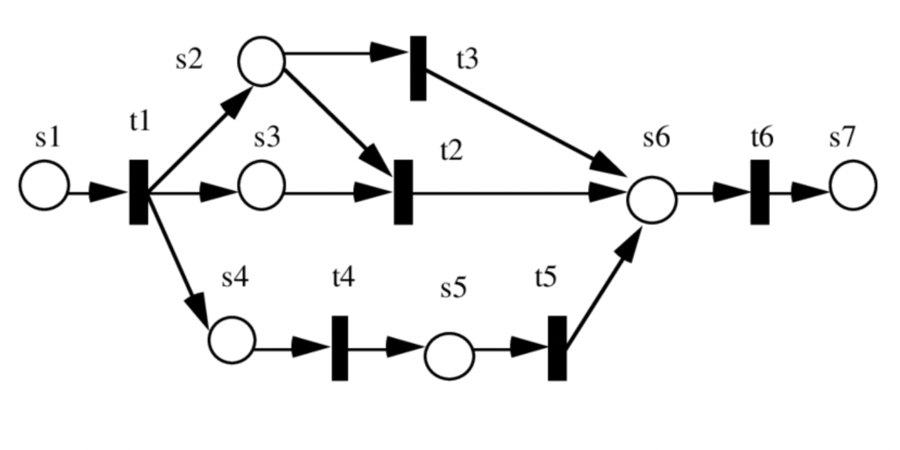

Slide 32
What should the interface look like?
Upper/lower bounds
Functional specifications
Natural language text
Simple, executable programs
Documentation
Readability
IRs like LLVM
Precise IR as Petri nets
Cycle-accurate model,
Accelerator implementation
Precision
Notes:
A key question we need to answer is what should the performance interface for an accelerator look like?
Any representation must provide a balance between readability (that is, how easy it is to understand) and precision (how accurately it can reason about performance).
The only interfaces available to developers and tools today occupy the two ends of the spectrum.
Accelerators, sometimes come with upper/lower bounds which maximize readability but provide little useful information for realistic workloads.
Or, developers are forced to rely on cycle-accurate models and the accelerator’s implementation itself, which are perfectly precise but hard to understand.
Some of you might argue that cycle accurate models and implementations are overkills as interfaces, and you’re right. They are, since they provide a lot more information than the interface needs to. Nevertheless, I’m including them here, because that’s what developers and tools are forced to use today.
[Pause] In this work, we propose three candidate representations (1) natural language text akin to documentation, (2) simple, executable programs akin to functional specifications, and (3) a precise intermediate representation using Petri nets akin to IRs like LLVM that allow compilers to reason about software semantics.
Each interface provides a different balance between readability and precision:
Natural language interfaces are the easiest to read but can only describe a few key performance properties.
Programs are slightly harder for developers to read but can provide more details, and
Finally, Petri nets are not human-readable but can accurately predict the accelerator’s throughput and latency for arbitrary workloads.

Slide 33
What should the interface look like?
Upper/lower bounds
Functional specifications
Natural language text
Simple, executable programs
Documentation
Readability
IRs like LLVM
Precise IR as Petri nets
Cycle-accurate
models
Precision
Notes:
I will now describe our initial experiences summarizing performance using each of these representations, starting with the natural language text.

Slide 34
What should the interface look like?
Natural language text (akin to documentation)
Simple, executable programs (akin to functional specifications)
Readability
Precise Intermediate Representation (IR) as Petri nets (akin to IRs such as LLVM)
Precision
Notes:
We propose three candidate representations for performance interfaces: (1) natural language (English), (2) simple, executable programs (Python), and (3) a Petri net [47]. We picked these three representations as counterparts to widely used representations for semantic interfaces: we expect the English text to resemble semantic interfaces extracted from code documentation by frameworks such as Doxygen [18] and Javadoc [32], the Python programs to resemble functional specifications, and the Petri nets to resemble an intermediate representation like LLVM. Each representation provides a different balance between human readability (being smaller and simpler than the implementation) and precision (being accurate enough to reason about the several factors that impact performance). Natural language interfaces are the easiest to read but can only describe a few key performance properties. Programs are harder for developers to read but can provide more details such as the specific request types the accelerator is best suited for. Finally, Petri nets are not human-readable but can accurately (< 2% average error in our experiments) predict the accelerator’s throughput and latency for arbitrary workloads
We envision these interfaces being provided by accelerator vendors and shipping with the accelerator, just like semantic interfaces are provided today.

Slide 35
What should the interface look like?
Upper/lower bounds
Functional specifications
Natural language text
Simple, executable programs
Documentation
Readability
IRs like LLVM
Precise IR as Petri nets
Cycle-accurate
models
Precision
Notes:
That was interfaces as programs, I’ll now move on to our performance IR using Petri nets.

Slide 36
What should the interface look like?
Upper/lower bounds
Functional specifications
Natural language text
Simple, executable programs
Documentation
Readability
IRs like LLVM
Precise IR as Petri nets
Cycle-accurate
models
Precision
Notes:
I will now move onto interfaces as simple executable programs.

Slide 37
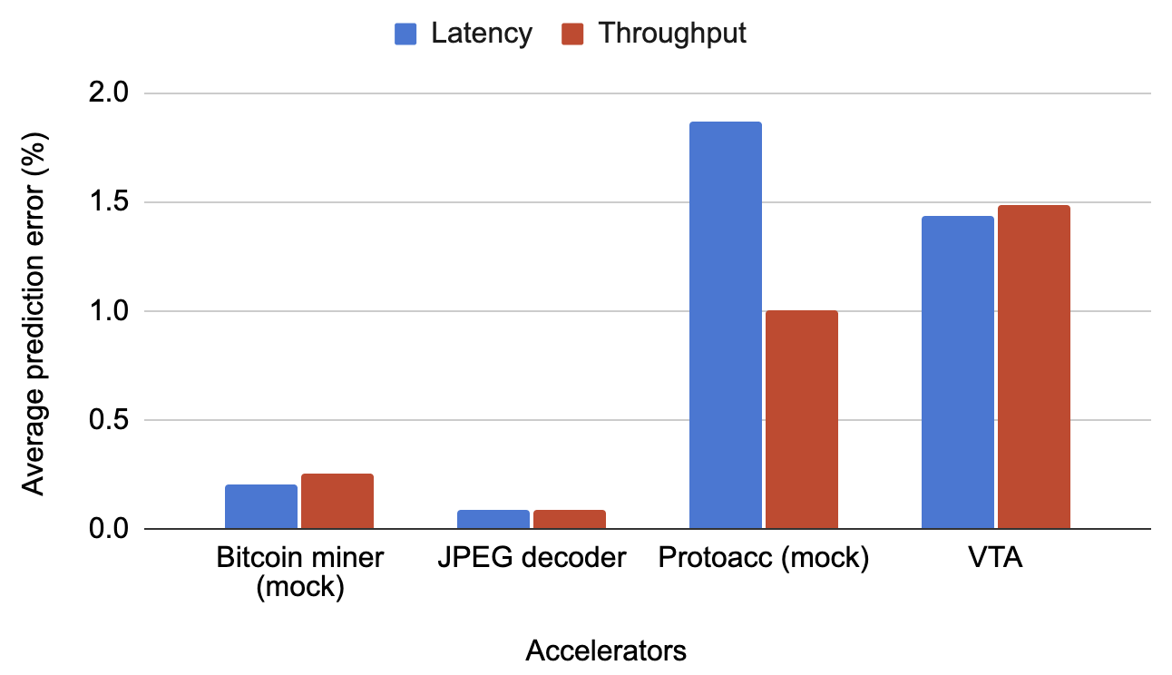
Interfaces as Petri nets as precise
Petri nets can accurately predict the accelerator’s expected latency and throughput for arbitrary input workloads
Notes:
[Slide 3: Properties of an ideal interface]
We’re designing our performance interfaces with two categories of target audience in mind --- developers and operators.
The developers of a system are the ones who wrote the code and are thus fairly familiar with low-level details.
Operators on the other hand are the ones who deploy/use the system in question. Since they didn’t write the code, they are not familiar with its low-level details. Further, they care less about all possible performance behavior the system can exhibit, and more about the performance of the system in their particular deployment, for instance their workload and hardware.
So, let’s now look at how our proposal for performance interfaces meets our design goals, for our target audience.

Slide 38
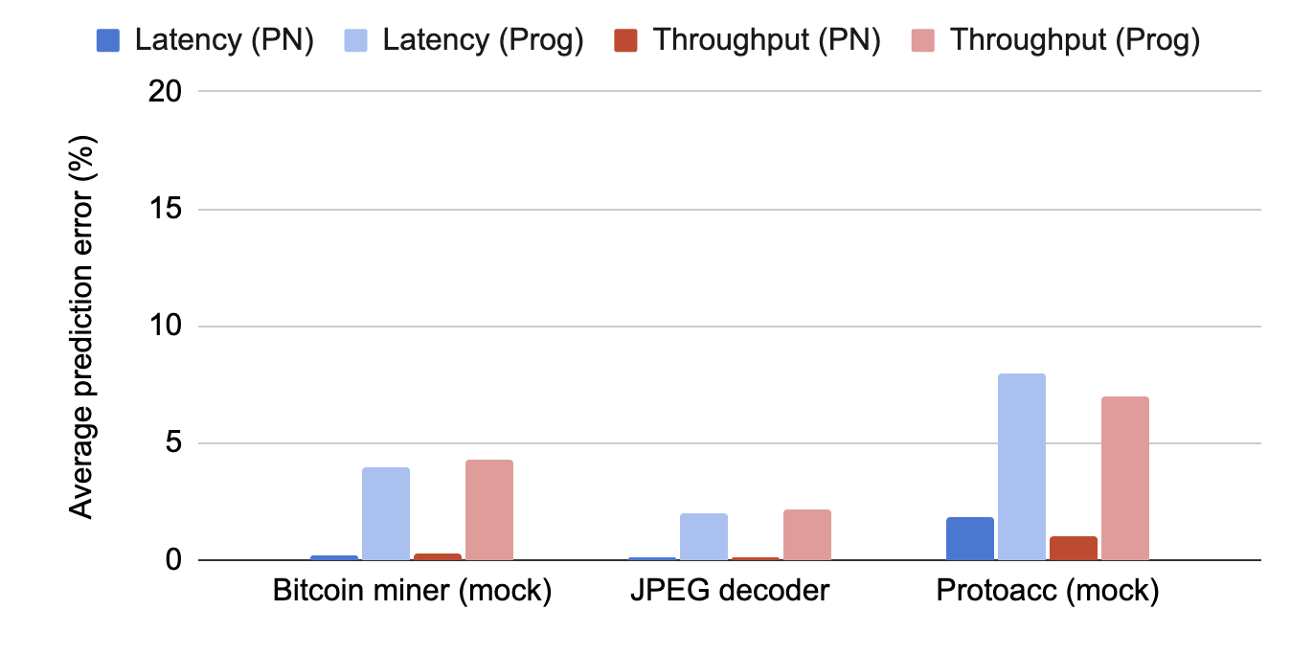
Interfaces as programs: precision
Interfaces as programs are precise enough to be useful

